Slide 1
Supporting presentation for lecturers of Architecture/Civil Engineering
Chapter 02B:
Applications - Infrastructure

Slide 2
Contents
  Water distribution
  Bridges
  Coastal Works

Slide 3
1. Water distribution

Slide 4
Why are stainless steels used?
Low Leakage Rates: Stainless Steels do not suffer from uniform corrosion like their ductile iron or steel counterparts, which can result in the rupture and failure of pipelines. Stainless valves never seize. With proper design, stainless distribution can operate safely in earthquake-prone areas
Hygienic: Stainless Steels are basically inert in potable waters, which maintains water quality and drinking water integrity.
Extended Service Life: Stainless steel components can provide 100 years of service due to their excellent corrosion resistance. They resist corrosion in most soils and do not require coatings or electrochemical protection systems
Recyclable: Unlike cement lined and non-metallic pipe, Stainless Steels are easily recycled and their alloy content is highly valued
Stainless is used for new large capacity reservoirs, new or for retrofitting existing ones

Slide 5
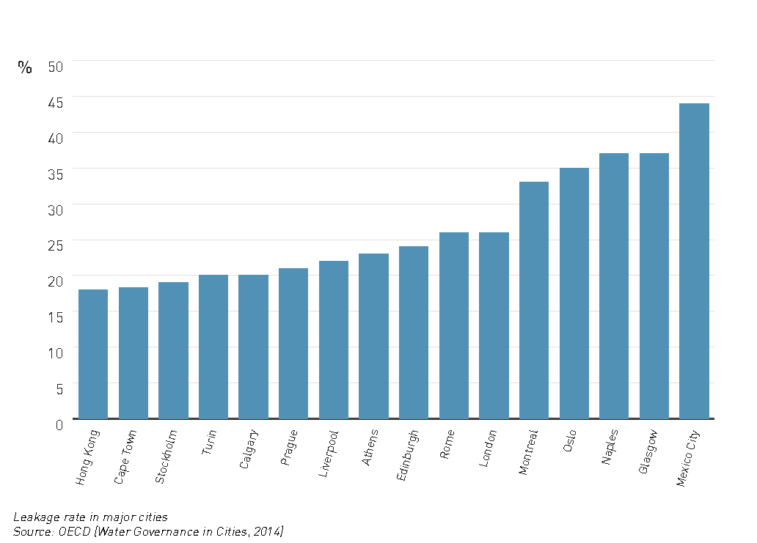
Water leakage rate in some major cities (2014) ¹

Slide 6
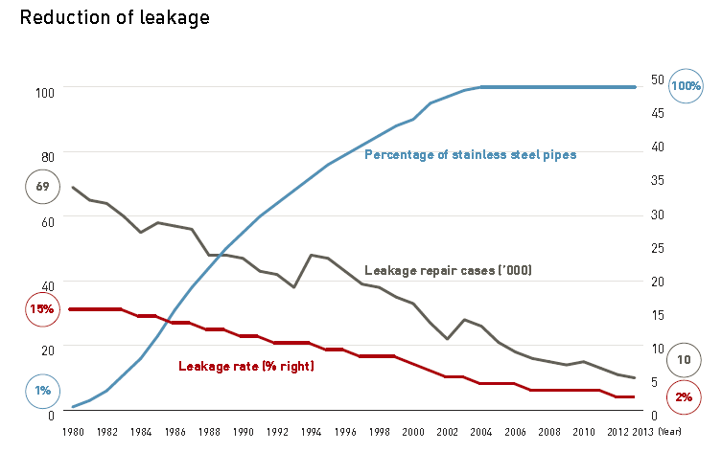
Reduction of leaks vs stainless steel pipe use in Tokyo¹

Slide 7
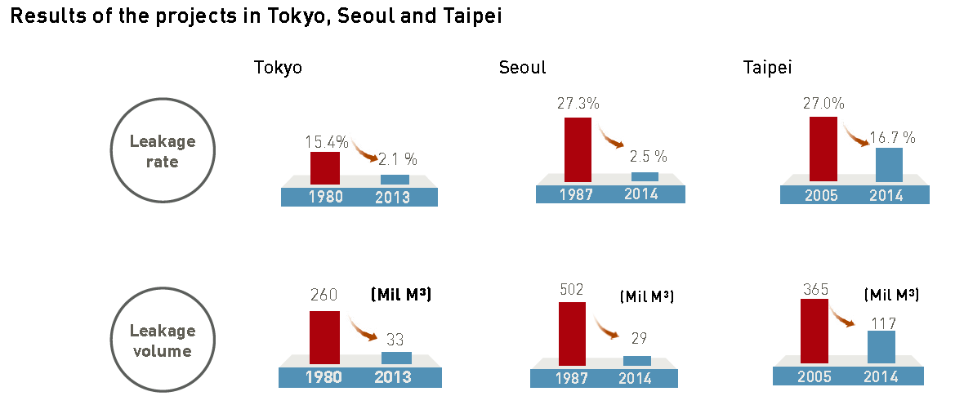
Reduction of water leakage with the replacement of old water pipes with stainless steel ⁸

Slide 8
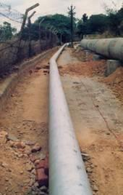
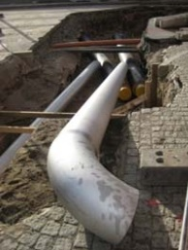
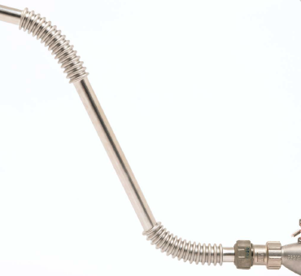
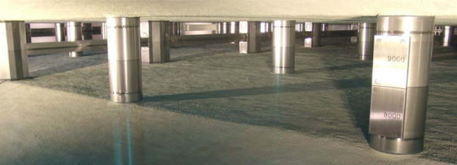

Slide 9
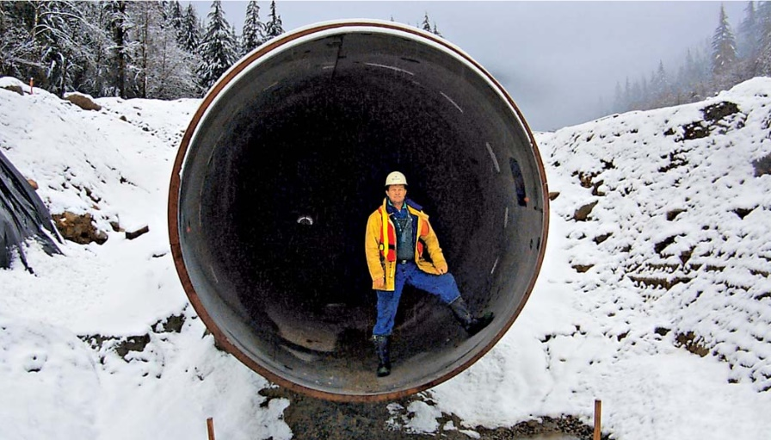

Slide 10
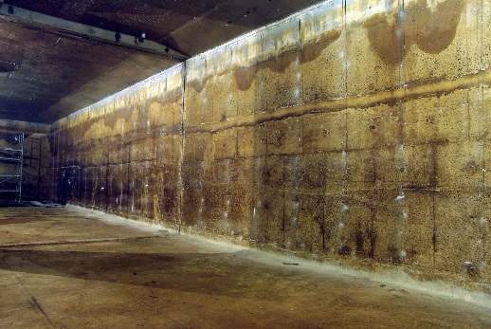
Water reservoir before repairs,
Gangneung-City, Korea²
The corrosion and deterioration of concrete is visible on the picture and causes water leakage.
Epoxy coating was rejected as not lasting .
Retrofitting with a Stainless steel lining was selected for corrosion resistance, durability, no maintenance and no bacterial growth.
BEFORE

Slide 11
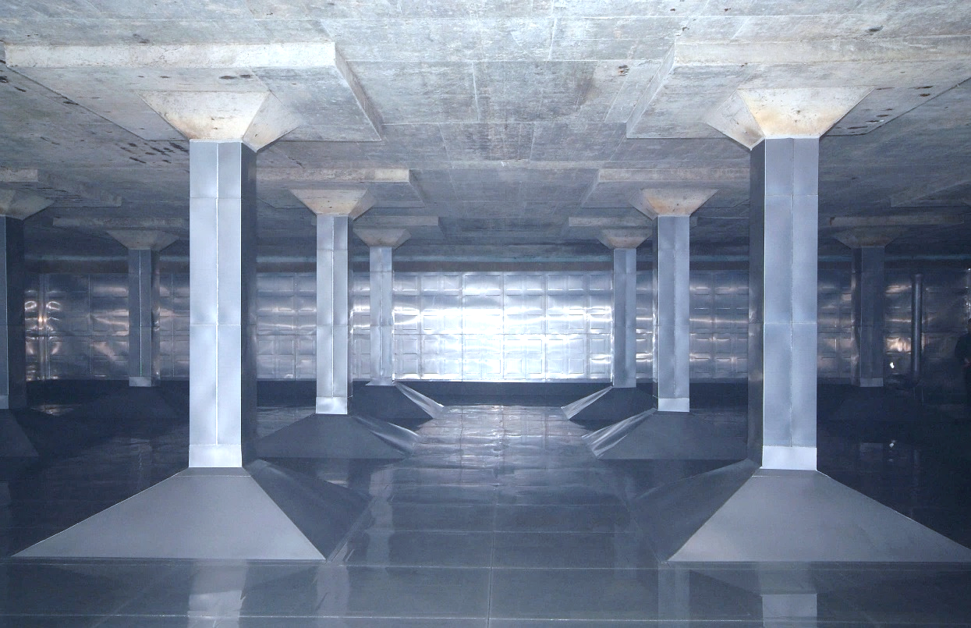
Same after new stainless steel lining
Duplex Stainless steel Grades STS329LD and STS329J3L are used.
Panels are welded together and anchored into the concrete.
AFTER

Slide 12
Water distribution References
http://www.nickelinstitute.org/en/NickelUseInSociety/MaterialsSelectionAndUse/Water/Distribution.aspx
http://www.imoa.info/download_files/stainless-steel/Stainless_Steel_Pipe.pdf
https://www.worldstainless.org/Files/issf/non-image-files/PDF/Euro_Inox/Cutler_water_EN.pdf
https://www.worldstainless.org/Files/issf/non-image-files/PDF/ISSF_A_workable_solution.pdf
Source: POSCO, Korea (http://www.posco.com)
https://www.worldstainless.org/Files/ISSF/non-image-files/PDF/ISSF_Stainless_Steel_in_Drinking_Water_Supply.pdf
https://worldstainless.org/applications/applications-for-the-protection-of-the-environment-and-human-health/protection-of-water/
https://www.worldstainless.org/Files/issf/non-image-files/PDF/Euro_Inox/CorrResist_SoilsConcrete_EN.pdf
https://www.nickelinstitute.org/~/Media/Files/TechnicalLiterature/FieldCorrosionResistanceTestOnStStPipingForBuildingService_12012_.pdf
https://worldstainless.org/applications/applications-for-the-protection-of-the-environment-and-human-health/protection-of-water/

Slide 13
2. Bridges
NEW!

Slide 14
Many Bridges are in a poor condition
NEW!
A lot of them were built after World War 2
For a projected life of 60 years plus
Traffic has been heavier than planned
Cutting maintenance costs has been a frequent practice

Slide 15
Situation in the European Union
NEW!
There is no comprehensive report published
Varies from country to country
Germany: 12.5 percent of Germany's motorway bridges are in good condition, while 12.4 percent are in poor condition
France: a recent report concluded 1/3 of the bridges are in a bad condition
etc…

Slide 16
The US Situation
Number of US bridges in need of replacement or rehabilitation, including structurally deficient bridges

Slide 17
Stainless steel in bridges
NEW!
Some examples

Slide 18
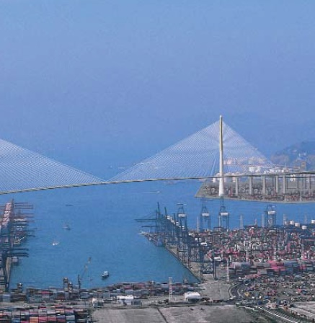
Stonecutter’s, Hong Kong
NEW!
This heavily-trafficked iconic bridge is located in an urban area, and has been designed to withstand tropical weather conditions, urban pollution, sea mist, wind, typhoons, accidental loads due to ship impacts and seismic loading.
It was at the time (2009) the first cable-stayed bridge exceeding a 1km span and has an expected lifetime of 120 years. Duplex stainless steel UNS S32205 (EN1.4462) was used as skin around concrete for the upper part of the towers, for the cable-stay anchorage and for reinforcing bar of the foundations and lower parts of the towers.

Slide 19
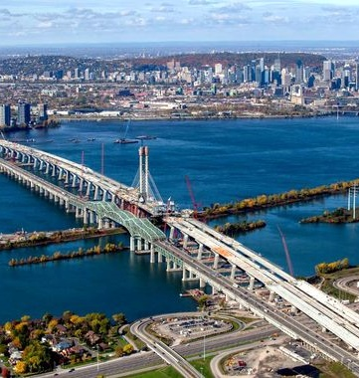
Champlain, Montreal
NEW!
The new bridge (2019), which replaces the old one that was failing due to corrosion, will resist severe freeze-thaw cycles with temperatures as low as -25°C to up to 30°C. It is 3.4km long, spans over the St. Lawrence river and the seaway and will carry over 50 millions vehicles per year. It features a 4-lane highway, a commuter rail line, bicycle tracks and lookouts for sightseeing. Over 15000T of stainless steel S32305 (EN1.4362) were used in the critical parts of the structure.
The old bridge opened in 1962. In spite of extensive maintenance it had to be replaced. The new bridge costs about 4200Million CAD. In addition, de-construction of the old one will cost 400Million CAD.

Slide 20
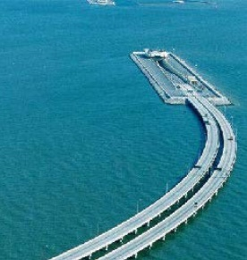
Hong Kong, Zhuhai, Macau
NEW!
The bridge is a part of a 50km link consisting of a series of three cable stayed bridges, one 6.7 km undersea tunnel, and 3 artificial islands. The bridge was constructed over 9 years, at an estimated cost of $20 billion for a lifetime of 100 years and was completed in 2018.
Over 10000T of duplex stainless steel were used in the critical areas

Slide 21
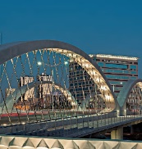

Fort Worth, Texas
NEW!
This is the world’s first arch bridge made of precast elements, 12 in total and was completed in 2013. The innovative feature is the load-bearing angled hanger bars that connect the top and the bottom of the arch bridge. They provide stability and structural performance.
They are made of duplex stainless steel grade S32205 (EN1.4462). The overall design is structurally very efficient, very elegant and ensures long-term durability.

Slide 22
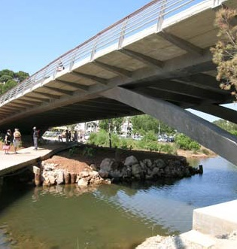
Cala Galdana, Menorca
NEW!
This stainless steel bridge, commissioned in 2005, replaces a carbon steel reinforced concrete structure.
Duplex grade S32205 (EN1.4462) was selected over carbon steel for its higher mechanical properties and corrosion resistance. The minimum Yield strength specified was 460Mpa, for a measured value of 535MPa, while the specified value for Carbon steel was only 355Mpa.

Slide 23
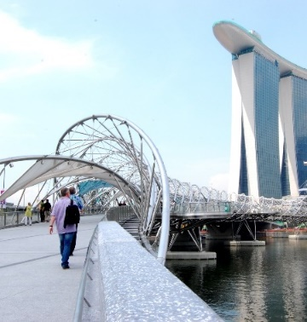
Helix, Singapore
NEW!
Its unique double helix structure, 280m long, supporting a walkway is made of tubes and plates of duplex S32205 (EN1.4462). This grade has been selected for its strength and corrosion resistance in a tropical maritime environment. The life cycle cost of the bridge will be lower than that of a carbon steel solution. The white light at night is particularly beautiful, enhanced by the surface finish of the stainless steel.

Slide 24
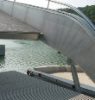
Lyon, France
NEW!
Located in an area that underwent a major upgrading and close to the new Musée des Confluences, this duplex stainless steel pedestrian bridge opens up to allow the passage of ships entering the docks. It is elegant, aesthetic and requires no maintenance.

Slide 25
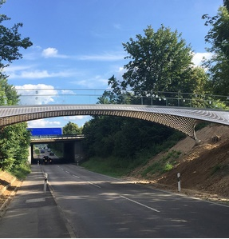
Trumpf, Germany
NEW!
This footbridge over the heavily trafficked Gerlinger Strasse connects two work sites at the TRUMPF Headquarters in Ditzingen, Germany.
Made of thin, strong , corrosion resistant duplex grades S32205 (EN1.4462) cut with TRUMPF laser technology, it has a very original shape that everyone remembers.
It demonstrates that duplex is not for iconic structures only.

Slide 26
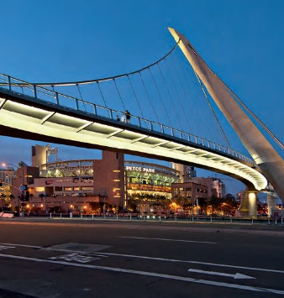
San Diego Harbor, California
NEW!
This self-anchored suspension structure, 168m long, is strikingly beautiful. The curved deck is supported by stay cables attached to a single inclined pylon, resulting in a very simple and attractive design. Duplex stainless steel grade S31803 and austenitic 317L have been selected for structural parts, railings, cables and connectors. The expected life time will exceed 100 years in this marine environment.

Slide 27
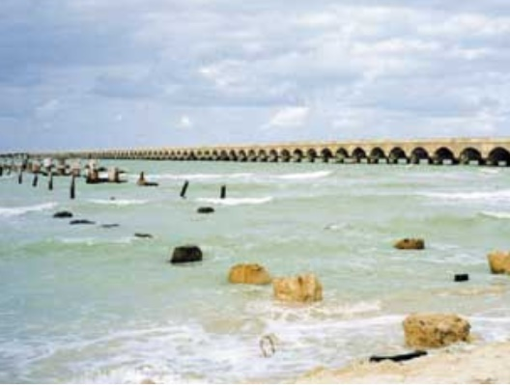
Progreso Pier, Mexico
NEW!
On the left, what remains of a pier which was built in 1970. The marine environment made the carbon steel rebar corrode – the structure failed.
On the right, the neighbouring pier erected in 1937 – 1941 using 304 stainless steel reinforcement which has been maintenance free and remained in pristine condition.

Slide 28
References on the condition of existing bridges
NEW!
https://www.theguardian.com/world/2018/aug/16/bridges-across-europe-are-in-a-dangerous-state-warn-experts
https://ec.europa.eu/jrc/en/news/keeping-european-bridges-safe
https://www.thelocal.de/20180815/bridge-collapse-cannot-be-ruled-out-in-germany-says-expert
https://www.bast.de/BASt_2017/DE/Ingenieurbau/Statistik/statistik-node.html
https://www.lemonde.fr/securite-routiere/article/2018/08/15/un-pont-sur-trois-a-besoin-de-reparations-sur-les-routes-nationales-francaises-selon-un-rapport_5342799_1655513.html
https://edition.cnn.com/2019/04/02/us/deficient-bridge-report-2019-trnd/index.html
https://artbabridgereport.org/
https://www.infrastructurereportcard.org/cat-item/bridges/

Slide 29
References on bridges with stainless steel
NEW!
IMOA web publication “Stainless steel in Vehicular, rail and pedestrian bridges” (March 2018) https://www.imoa.info/stainless-solutions/archive/37/Vehicular-rail-and-pedestrian-bridges.php
C Houska “More on duplex stainless steel and bridges “, The construction specifier, (May015) https://www.constructionspecifier.com/duplex-bridges/
EU Publication report “Application of duplex stainless steel for welded bridge construction in an aggressive environment”, (march 2009), ISBN 978-92-79-09948-9 https://publications.europa.eu/en/publication-detail/-/publication/ec2748d4-3269-43cd-9a34-3a0e1fba4e23/language-en/format-PDF/source-79161265
Euro Inox publication « Pedestrian bridges in stainless steel » ISBN 2 87997 084 9 https://www.bssa.org.uk/cms/File/Euro%20Inox%20Publications/Pedestrian%20Bridges.pdf
N. Baddoo and A. Kosmač “Sustainable Duplex Sainless Steel bridges” Euro Inox publication www.worldstainless.org/Files/issf/non-image-files/PDF/Sustainable_Duplex_Stainless_Steel_Bridges.pdf
“San Diego’s new harbor bridge sails onto the skyline” MolyReview, (June2012) https://www.imoa.info/molybdenum-uses/molybdenum-grade-stainless-steels/architecture/pedestrian-bridges.php

Slide 30
References on bridges with stainless steel
NEW!
K F. Hansen, L. Lauge and S. Kite: “Stonecuttes bridge –Detailed design” (January 2004) DOI: 10.2749/222137804796291719 https://www.researchgate.net/publication/233611421_Stonecutters_Bridge_-_Detailed_Design/link/59ce24d3aca272b0ec1a4b34/download
Steel Construction Institute publication : “Stonecutters bridge Towers”(2010) https://www.worldstainless.org/files/issf/non-image-files/PDF/Structural/Stonecutters_Bridge_Towers.pdf
G. Gedge: “Use of duplex stainless steel plate for durable bridge construction” (January 2007) DOI: 10.2749/222137807796119771 https://www.researchgate.net/publication/233632633_Use_of_Duplex_Stainless_Steel_Plate_for_Durable_Bridge_Construction
Champlain bridge, Montreal Nickel Institute magazine, Vol. 34, N°2, (2019) https://www.nickelinstitute.org/nickel-magazine/nickel-magazine-vol34-no2-2019/?lang=English&p=6
Champlain bridge, Montreal Stainless Steel World online, 05 January 2016 http://www.stainless-steel-world.net/news/58262/nas-to-supply-stainless-steel-bar.html
Hong-Kong Macau bridge ISSF Publication: “Stainless steel in Infrastructure” https://www.worldstainless.org/Files/issf/non-image-files/PDF/ISSF_Stainless_Steel_in_Infrastructure_English.pdf

Slide 31
References on bridges with stainless steel
NEW!
Hong-Kong Macau bridge https://en.wikipedia.org/wiki/Hong_Kong%E2%80%93Zhuhai%E2%80%93Macau_Bridge
IMOA publication “Innovative bridge at Ft Worth, Texas” Moly-Review 1/2018 https://www.imoa.info/molybdenum-media-centre/downloads/
Steel Construction Institute publication: “Cala Galdana Bridge” (2010) http://www.worldstainless.org/architecture_building_and_construction_applications/structural_applications
Railways Bridges in India https://www.apnnews.com/pamban-to-become-indias-first-railway-bridge-to-use-stainless-steel-structurals/
Steel Construction Institute publication: “Helix Pedestrian Bridge” (2011) https://worldstainless.org/files/issf/non-image-files/PDF/Structural/Helix_Pedestrian_Bridge.pdf
ISSF Publication: Bascule pedestrian bridge in “Stainless steel as an architectural material” https://www.worldstainless.org/Files/issf/non-image-files/PDF/ISSF_Stainless_Steel_as_an_Architectural_Material.pdf
Trumpf bridge https://www.outokumpu.com/en/choose-stainless/2018/case-pedestrian-bridge-at-trumpf-headquarters
IMOA Publication “San Diego’s new harbor bridge sails onto the skyline” MolyReview, (June2012) https://www.imoa.info/molybdenum-uses/molybdenum-grade-stainless-steels/architecture/pedestrian-bridges.php

Slide 32
3. Coastal Infrastructure
NEW!
37% of the world’s population lives within 100km of the coast
Notes:
https://www.unenvironment.org/explore-topics/oceans-seas/what-we-do/working-regional-seas/coastal-zone-management
https://www.lavoisier.fr/livre/genie-civil-BTP/climate-change-and-the-coast/descriptif_3917674
https://www.novethic.fr/actualite/environnement/biodiversite/isr-rse/le-changement-climatique-grignote-nos-cotes-et-menace-plus-d-un-million-de-francais-147571.html

Slide 33
Climate change and coasts
NEW!
A few consequences:
Oceans are rising at a rate of about 3mm/year…and will not go back! Some land is already/will be flooded
Extreme meteorological events are more frequent (such as class 5 hurricanes, super typhoons…), adding to coastal damage
Major changes on coastal ecosystems, mostly destruction, are taking place
Human populations and activities are threatened with a huge human and economic cost.
Notes:
IPCC report
the
coastal zone chapter of the United Nations Environment Programme (UNEP) Handbook on
Methods for Climate Change Impacts Assessment and Adaptation Strategies (Klein and Nicholls,
1998) and other relevant literature (e.g., Klein et al., 1999).

Slide 34
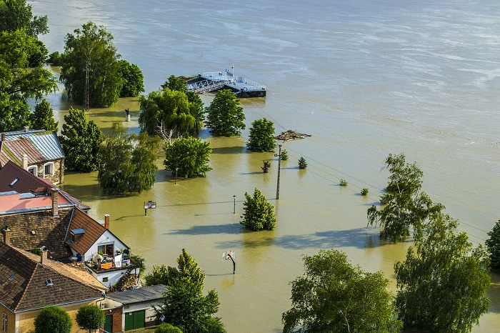
Flooding (Southwest France)
NEW!
Notes:
https://www.novethic.fr/actualite/environnement/biodiversite/isr-rse/le-changement-climatique-grignote-nos-cotes-et-menace-plus-d-un-million-de-francais-147571.html
https://www.cerema.fr/fr/actualites/adapter-documents-conception-entretien-exploitation
https://www.cerema.fr/fr/evenements/territoires-littoraux-transition-face-au-changement

Slide 35
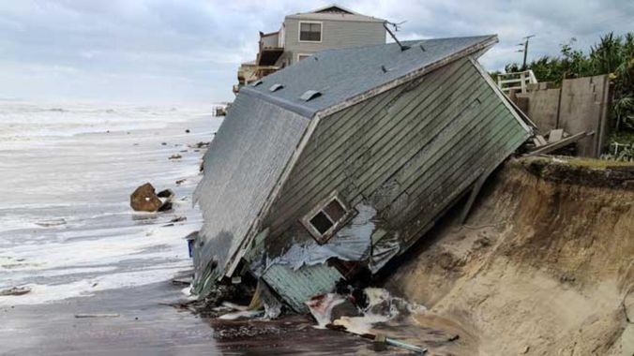
Coastal damage (location unknown)
NEW!

Slide 36
Coastal adaptation options
NEW!
Managed retreat (e.g. movable structures, inland flood defences, flood warning systems)
Accommodation (e.g. reservoir relocation, dune management, rain/waste-water management)
Protection (includes a wide array of technologies available to coastal engineers to stabilize a coastline, including soft technologies such as beach nourishment as well as hard structures such as sea walls, revetments, groynes)
Source: www.unfccc.int/resource/docs/tp/tp0199.pdf
https://www.unenvironment.org/explore-topics/oceans-seas/what-we-do/working-regional-seas/coastal-zone-management

Slide 37
Some structures for protection that use stainless steel
NEW!

Slide 38
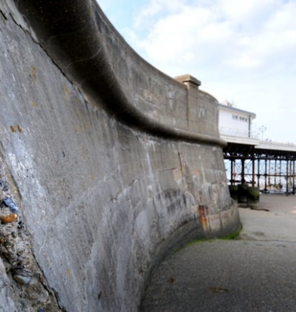
Sea Wall, Cromer, UK
NEW!
Cromer is a beautiful North Norfolk seaside resort from the Victorian times. Protection against the sea is achieved by a concrete sea wall and by timber groynes.
Following a major storm in 2013, large and expensive repairs had to be carried out, not only to maintain the actual level of defense, but also to anticipate 100 years of predicted sea level rise.
In this project, over 300 MT of S32304 (EN1.4362) duplex stainless steel rebar were used.

Slide 39
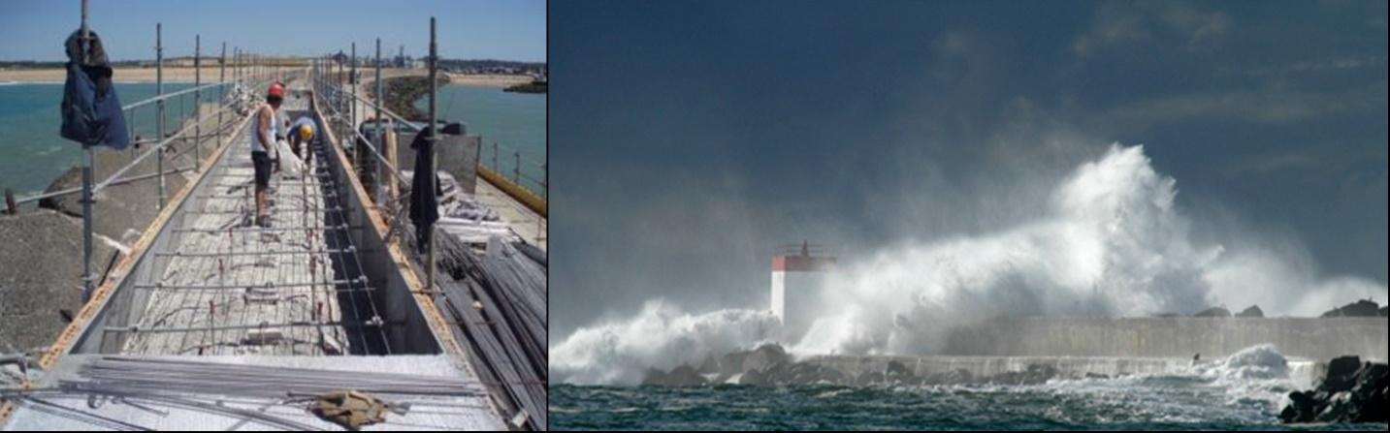
Breakwater, Bayonne, France
NEW!
The breakwater, built in the 1960s, protects the entrance of the Bayonne harbor against storms. It features a wall and a platform wide and strong enough to bear a heavy duty crane. This crane replaces the 40T concrete blocks that dissipate the energy of the incoming waves on the sea side as they wear out.
As the platform itself eventually started to show cracks, it has been repaired using high strength S32205 (EN1.4462) duplex stainless steel rebar (Yield stress min 750Mpa), allowing a significant reduction of tonnage. In the end only 130 Tons of rebar were needed.

Slide 40
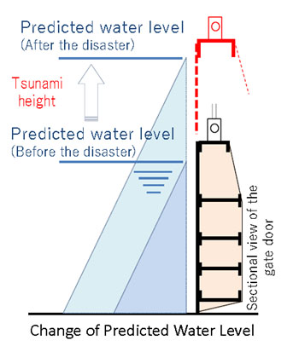
Safety measures in Japan
NEW!
Contribution to reconstruction of the disasters and the national resilience
The number of deaths caused by the Great East Japan Earthquake in March 2011 was approximately 16,000, and more than 90% of those killed by tsunami, which was exceptionally large.
After the Earthquake, Japanese Government changed the specification of the height of the water gates from 5m to 8m. This upsizing led the increase of water pressure and it was required to increase the strength of the gates with additional the design.
Solution: NIPPON STEEL Stainless Steel Corporation proposed Alloy-Saving Duplex Stainless Steel (ASDSS), which enabled reducing its weight and simplifying the design by its strength.
Source: NIPPON STEEL Stainless Steel Corporation

Slide 41
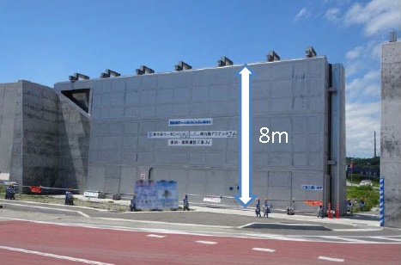
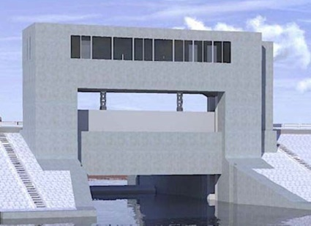
Examples of water gates in Japan
Slide gate
Height: 8.2 m x Width 15 m
Water gate
Height: 6.2 m x Width 15 m
Source: NIPPON STEEL Stainless Steel Corporation

Slide 42
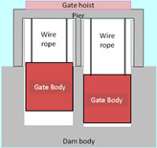
Weight reduction of water gates achieved by Lean Duplex stainless steel
Grades | Carbon steel (SM490) | Conventional SS (SUS 304) | ASDSS (NSSC2120)
Total weight | 16.1 (t/gate) | 14.7 (t/gate) | 12.1 (t/gate)
25% weight reduction
Design comparison (dam discharging gate
7m x 7.8m = 54.6m²)
Source: Electric power civil engineering (2016.9)

Slide 43
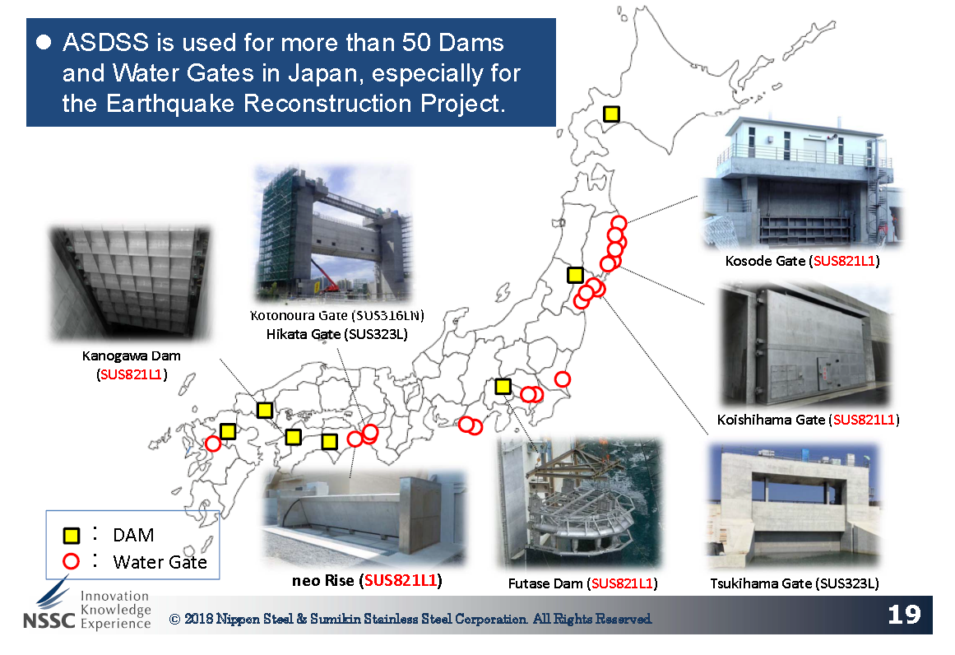
Some of the major projects in Japan
NEW!

Slide 44
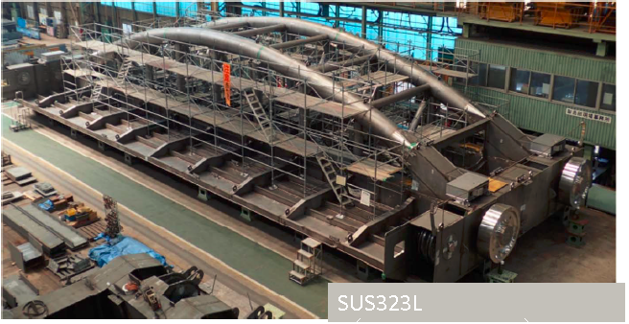
Kamihirai gate, Japan
NEW!
A view of the gate being built

Slide 45
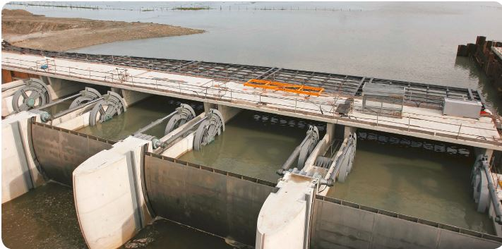
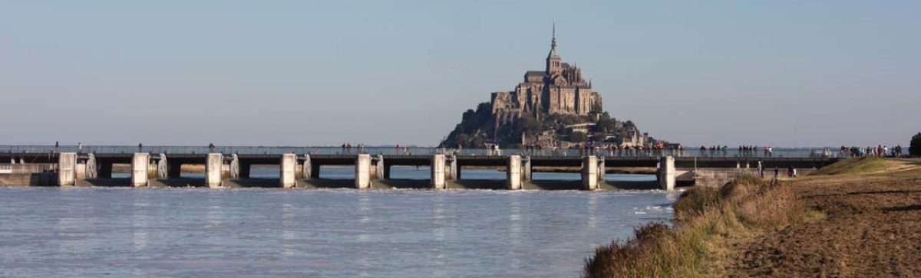
Mont Saint Michel, France
NEW!

Slide 46
Mont Saint Michel, France
NEW!
Mont Saint Michel is one of the most visited tourist spots of France. The tiny island with its cloister and with an angel on top is located in a bay. Over time, stilting of the bay was slowly taking place, changing the landscape.
Gates were built to store the water of the incoming stream during the incoming tides and release it at low tides, thereby taking away some sediments back to the sea twice per day. The eight sets of sluice gates clad were built using 36 T of S32205 (EN 1.4462) duplex stainless steel, selected for its good corrosion and abrasion resistance.
Mont Saint Michel now returns to the sea.

Slide 47
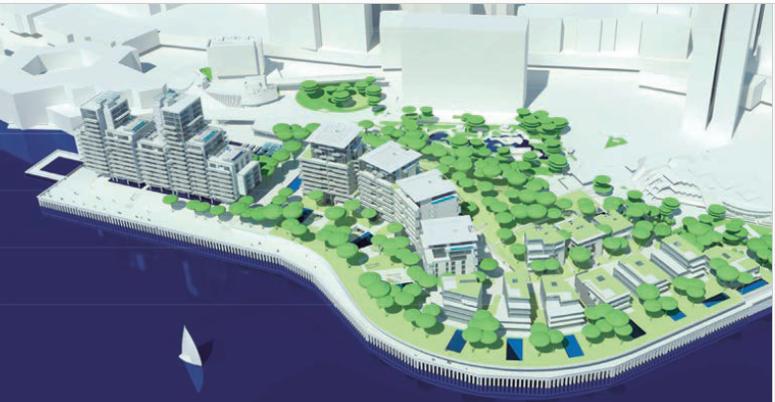
Monaco Extension over the sea
NEW!
The Principauté (principalty) de Monaco, on the Mediterranean coast, is expanding its tiny territory (2km²) over the sea to build a huge 600 000m² new city development, for an estimated cost of 2 billion Euros.
The technical challenges are huge: creating a temporary dam to build the enclosure; erecting the concrete wall capable of lasting at least 100 years, filling up the new space gained over the sea and preparing it for multi storey residential buildings, minimizing the impact on marine life, etc.
Over 4000MT of duplex S32304 (EN1.4362) stainless steel rebar will be used to reinforce the concrete walls and protect them against the corrosion by sea water.

Slide 48
References
NEW!
https://www.ipcc.ch/
www.unfccc.int/resource/docs/tp/tp0199.pdf
https://www.novethic.fr/actualite/environnement/biodiversite/isr-rse/le-changement-climatique-grignote-nos-cotes-et-menace-plus-d-un-million-de-francais-147571.html
https://www.cerema.fr/fr/actualites/adapter-documents-conception-entretien-exploitation
https://www.cerema.fr/fr/evenements/territoires-littoraux-transition-face-au-changement
https://www.unenvironment.org/explore-topics/oceans-seas/what-we-do/working-regional-seas/coastal-zone-management
Sea Wall at Cromer http://www.stainlesssteelrebar.org/applications/coastal-protection-at-cromer-uk/
Bayonne breakwater http://stainlesssteelrebar.org/applications/bayonne-breakwater/
https://www.constructioncayola.com/batiment/article/2008/11/20/23050/l-inox-pour-resister-atlantique
Tsunami-proof floodgates Japan (NSSC presentation)

Slide 49
References
NEW!
Sluices Mt St Michel https://www.nickelinstitute.org/en/NickelMagazine/MagazineHome/AllArchives/2015/Volume30-3/InUseMontStMichel.aspx?selected=year https://europe.arcelormittal.com/europeprojectgallery/fol_montsaintmichel
Tammeroski floodgate http://www.pratiwisteel.com/news/view/20110708090600/Outokumpu-Duplex-Stainless-Steel-For-Sluice-And-Flood-Gates-Structures-In-Finland.html https://www.pontek.fi/in-english
Monaco https://www.cedinox.es/opencms901/export/sites/cedinox/.galleries/publicaciones-tecnicas/Extension-en-mer-de-Monaco.pdf
Gårda Dämme floodgate, Göteborg https://www.outokumpu.com/en/choose-stainless/2016/floodgates-to-fight-rising-sea-levels
https://coastal-environments.weebly.com/landforms-and-processes.html

Slide 50
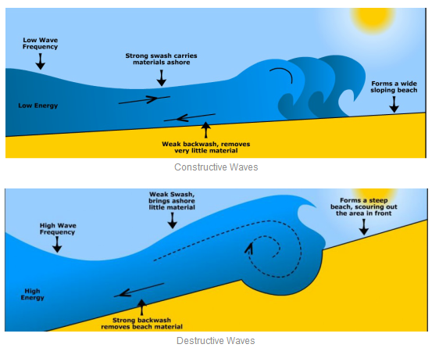
Waves construct and destruct the coastlines ¹
NEW!
https://coastal-environments.weebly.com/landforms-and-processes.html
Notes:
https://coastal-environments.weebly.com/landforms-and-processes.html

