Slide 1
Supporting presentation for lecturers of Architecture/Civil Engineering
Chapter 09
Joining & Fabrication of
Stainless Steels

Slide 2
Contents
Joining
Fabrication

Slide 3
1 - Joining Applicable joining processes: all of them!
Process (Refs) | Videos | Preferred process for
Welding (1-5) (widely used) | MIG Welding TIG Welding Welding robot | High strength of the joints No dismantling
Fastening (widely used) | Webinar | Easy on-site assembly Assembling dissimilar materials (wood, glass…) Dismantling at a later stage
Brazing/Soldering | Soldering | Water tightness (Used mostly in roofing)
Mechanical Press-fitting Folding Other …. | Press-fit_example | Permanent joining of tubes Water tighness
Adhesive Bonding (not used often, but growing) |  | Surface finish integrity

Slide 4
Arc Welding
Advantages of arc welding
Limitations of arc welding
weld properties equal to that of annealed condition
provides the strongest joints
can be done on site or in the shop
joins thin and thick material of any shape
joins similar or dissimilar metals (usually carbon steel with proper choice of filler material)
resists fatigue and cyclic loads
same corrosion and heat resistance as the annealed base metal
not possible with all grades
require qualified operators and procedures
may cause heat-induced distortions
post-weld finishing operations are required for a good-looking finish (such as sand blasting)
loss of mechanical properties in case of cold-worked material

Slide 5
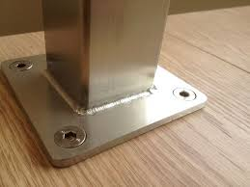
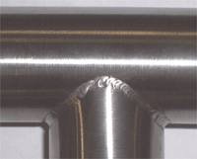
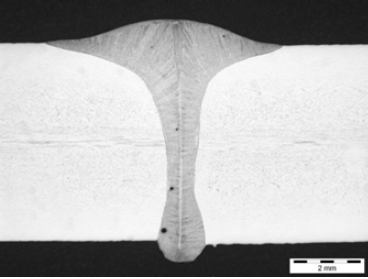
Arc Welding
Video: polishing a weld

Slide 6
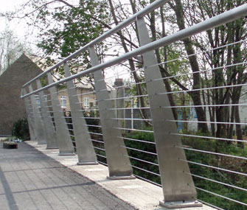
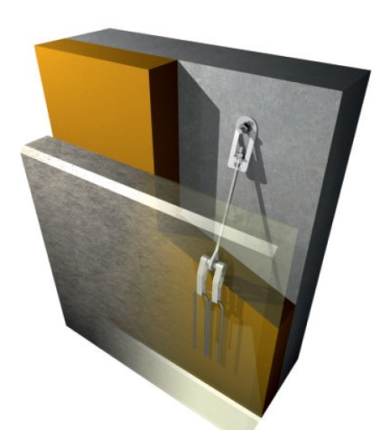
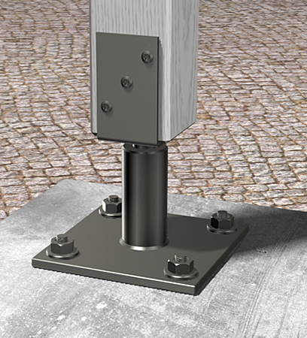
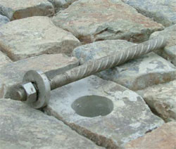
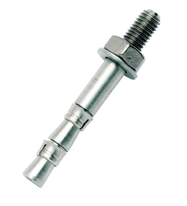
Mechanical fastening
Advantages of mechanical fastening
Can be dismantled
Ideal for on-site building
Fast
No need of qualified operators
Limitations of mechanical fastening
Not as strong as welds
May cause crevice corrosion (see corrosion resistance chapter)
Selecting the appropriate fastener:
The German Institute for Building Technology* has issued recommendations for the selection of fasteners according to the environment. Please read Reference 4, Table 1a (exposure classes) and Table 8 (stainless grades by class)
* Deutsches Institut für Bautechnik (DIBt)

Slide 7
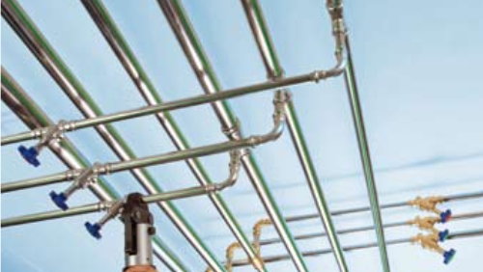
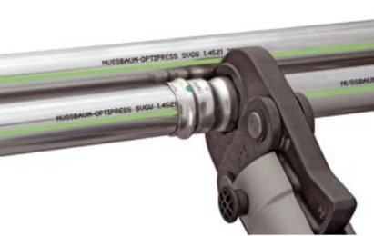
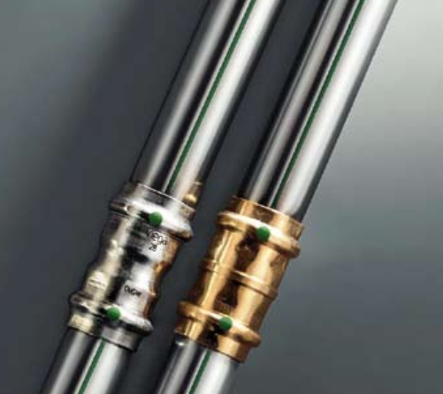
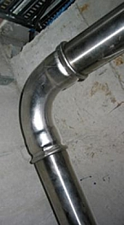
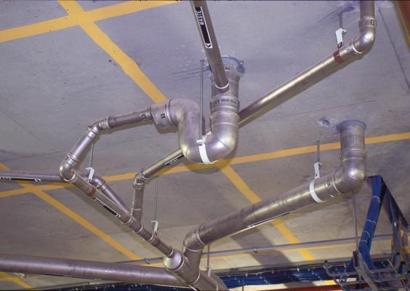
Press fitting (a process used for tubes only)
Advantages of press fitting
Perfectly tight for liquid and gases
Fast
No flame
Perfectly clean surfaces
No need of qualified operators
Limitations of press fitting
Cannot be dismantled
Require sleeves for each tube diameter

Slide 8
Adhesive Bonding
Advantages of adhesive bonding
Limitations of adhesive bonding
makes a joint almost invisible, enhancing
product appearance
provides uniform distribution of stress and a greater stress-bearing area
joins thin and thick material of any shape
joins similar or dissimilar materials
minimizes or prevents electrochemical (galvanic) corrosion between dissimilar
materials
resists fatigue and cyclic loads
provides joints with smooth contours
seals joints against a variety of environments
insulates against heat transfer and electrical conductance
is free from heat-induced distortions
dampens vibrations and absorb shocks
provides attractive strength/weight ratio
is frequently faster or cheaper than mechanical fastening
does not permit visual examination of the bond area
requires careful surface preparation, often with corrosive chemicals
may involve long cure times, particularly where high cure temperatures are not used
may require holding fixtures, presses, ovens and autoclaves, not usually needed for other fastening methods
should not be exposed to service temperatures above approximately 180 °C
requires rigid process control, including emphasis on cleanliness, for most adhesives
depends on the environment to which it is exposed

Slide 9
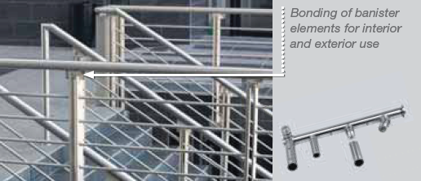
Adhesive bonding applications
 | Attaching of banister elements (Delo-Duopox AD895) Fills gaps, suitable for small and large bonding gaps Good chemical resistance and aging resistance For interior and exterior use Efficiency: flexible modular system in banister construction. The additional process steps required for welding, such as grinding or polishing, are avoided
 | Stainless steel panels (Grade 1.4404) are attached to the outer walls of this 6-storey office building in Hannover (Germany) using an adhesive bonding system without the need for additional mechanical fastening
Notes:
http://www.delo.de/fileadmin/upload/dokumente/en/broschueren/Structural_Bonding.pdf
http://www.thyssenkrupp-nirosta.de/en/news/news-archive/show/browse/2/article/first-use-of-adhesive-bonding-to-attach-stainless-steel-facade-panels-to-outer-building-walls/76/

Slide 10
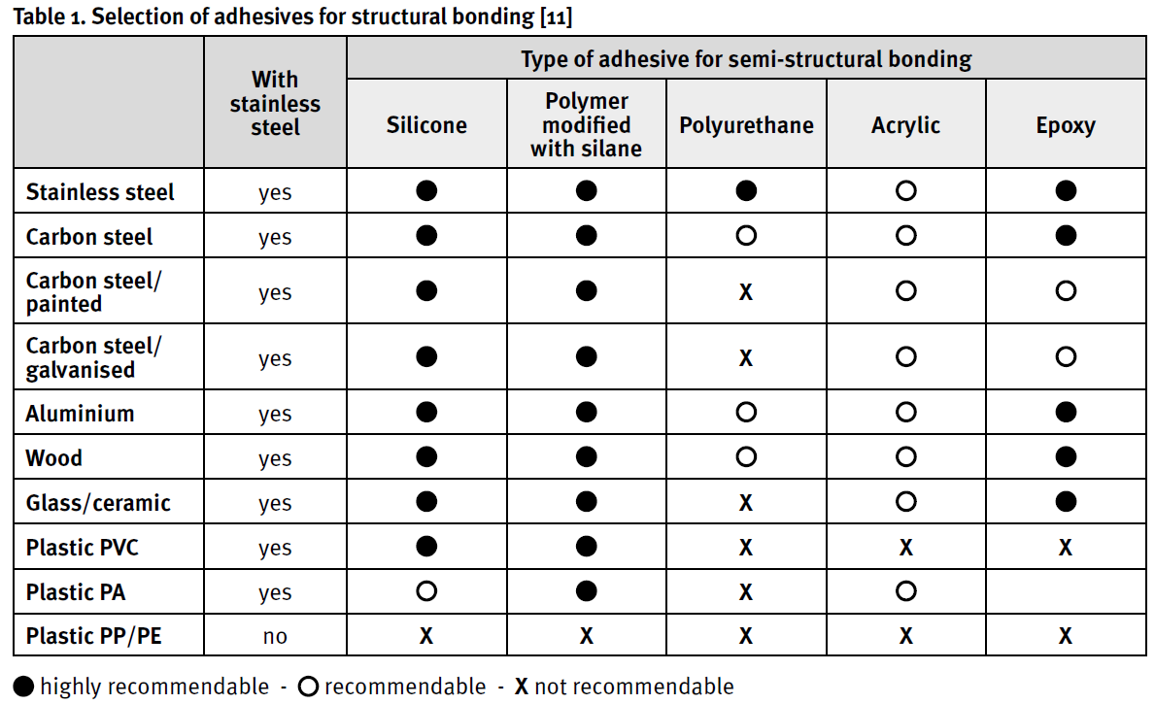
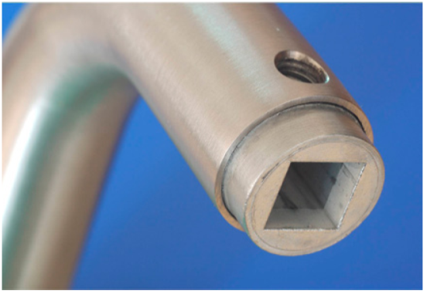
Adhesive bonding is used for the assembly of door handles.
Adhesive bonding is a practical solution in building applications, when stainless steel has to be fastened to masonry or natural stone
Notes:
Adhesive Bonding of Stainless Steels. 1st. Ed. 2013. Materials and Applications Series, volume 21. Euro Inox 2013
[11] Selection de collage structural, loctite, www.360bonding.com

Slide 11
References on Joining
http://www.worldstainless.org/Files/issf/animations/WeldedFabrication/start_1.html
http://www.wikihow.com/Weld-Stainless-Steel
http://www.nickelinstitute.org/~/Media/Files/TechnicalLiterature/WeldingofStainlesssSteelandotherJoiningMethods_9002_.pdf
http://www.edelstahl-rostfrei.de/page.asp?pageID=1590
http://www.improve.it/metro/file.php?file=/1/Papers/Metallurgy_of_Welding_Processes/Joint_properties.pdf
https://www.worldstainless.org/Files/issf/non-image-files/PDF/Euro_Inox/Adhesive_bonding_EN.pdf
http://shura.shu.ac.uk/3115/
https://www.worldstainless.org/Files/issf/non-image-files/PDF/ISSF_Stainless_Steel_for_Designers.pdf
http://www.delo.de/fileadmin/upload/dokumente/en/broschueren/Structural_Bonding.pdf
https://www.ellsworth.com/globalassets/literature-library/manufacturer/ellsworth-adhesives/ellsworth-adhesives-white-paper-structural-bonding.pdf
http://www.sciencedirect.com/science/book/9781845694357

Slide 12
2 - Fabrication
Very comprehensive documents are available, see the list of references
Ref 1 is a training course dedicated to the fabrication of stainless steels
Chapter 2 lists a number of applications in architecture, building and construction: fabrication of all shapes and finishes is achieved routinely today

Slide 13
Videos on Processes
Stainless Steel Melting and Rolling | https://www.youtube.com/watch?v=5zwgI-pQ6kE
Shearing and Bending | https://www.youtube.com/watch?v=VMu7_W0QE3Y
Water Jet Cutting | http://www.sastainless.com/videos/index.html
Deep Drawing | https://www.youtube.com/watch?v=n-ht_5Ysurc
Wire Bending Machine | https://www.youtube.com/watch?v=kDoSDiiZx6U
Spring Forming Machine | https://www.youtube.com/watch?v=SwY-RT4DBxY
Roll Forming | https://www.youtube.com/watch?v=44XD5mZoM_0
Machining (milling) | https://www.youtube.com/watch?v=LDxNDWObTyg
More videos are readily available on the net

Slide 14
References on Fabrication
http://www.issftraining.org/
http://www.imoa.info/download_files/stainless-steel/Austenitics.pdf
http://www.imoa.info/download_files/stainless-steel/Duplex_Stainless_Steel_3rd_Edition.pdf
http://www.worldstainless.org/Files/issf/non-image-files/PDF/ISSF_The_Ferritic_Solution_English.pdf

Slide 15
Thank you
Test your knowledge of stainless steel here:
https://www.surveymonkey.com/r/3BVK2X6

